Slide 1
Table of Contents
Title: 6.1 Formation of Sedimentary Rocks
Page #: 36
Date: 11/28/2012

Slide 2
Objective
Students will be able to sequence the formation of sedimentary rocks.
Explain the process of lithification.
Describe the features of sedimentary rocks.

Slide 3
Word of the Day
Texture: The physical appearance or feel of a rock.

Slide 4
Formation of Sedimentary Rocks
***Main Idea***: Sediments produced by weathering and erosion form sedimentary rocks through the process of lithification.

Slide 5
Weathering and Erosion
Sediments: Small pieces of rocks that are moved and deposited by water, wind, glaciers and gravity.
  Sediments may become glued together to create rocks.

Slide 6
Weathering and Erosion
Weathering: There are 2 kinds:
  Chemical: When minerals in rock are dissolved or chemically changed. (Acid rain)
  Physical: When minerals in a rock remain unchanged, but get broken.
  Chemical and Physical Weathering may occur together.

Slide 7
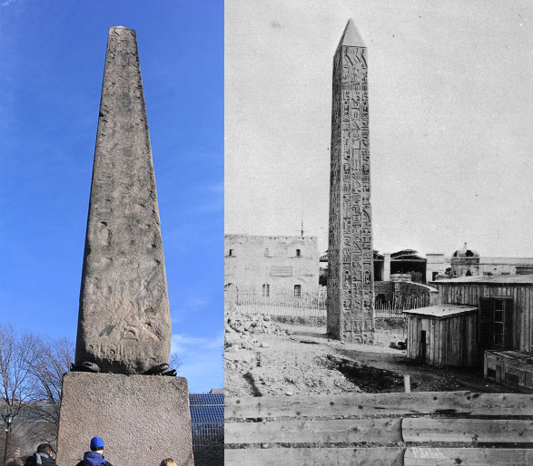
Cleopatra’s Needle.
Before photo on right.
After photo on left.
Writing has been washed away
By chemical weathering.

Slide 8
Weathering and Erosion
Erosion: The removal and transport of sediment (always moves down hill.)
  There are 4 agents (causes) of erosion:
    Wind
    Moving Water
    Gravity
    Glaciers

Slide 9
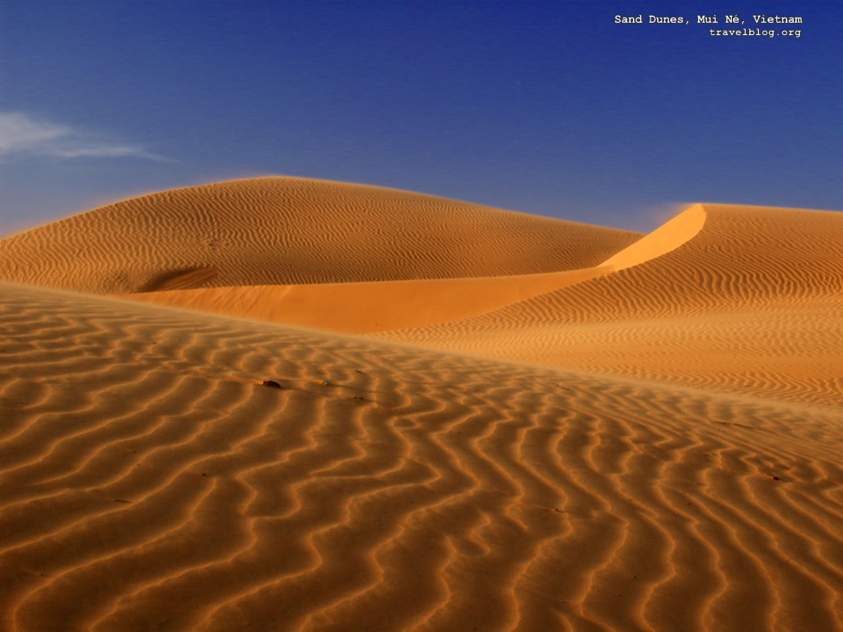
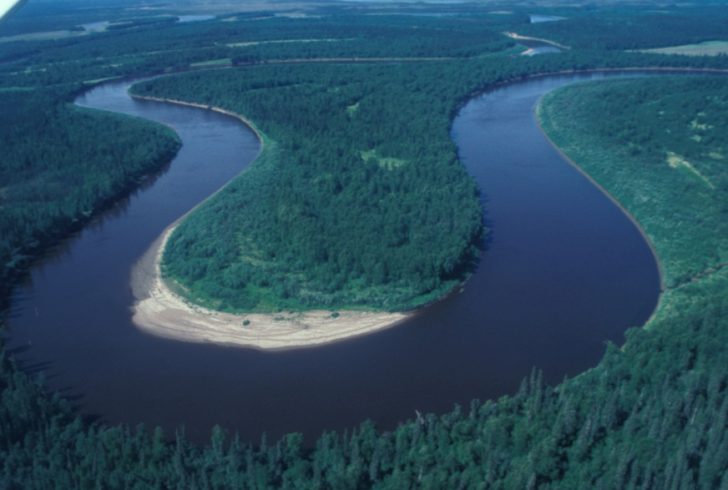
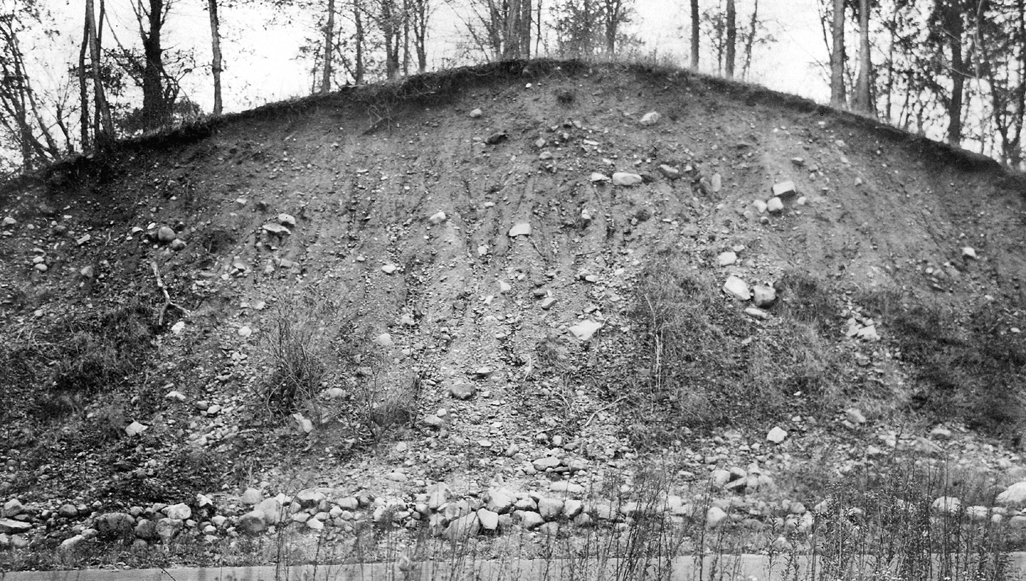
Sand dunes, deposited by wind.
Sediments deposited by river.
Mixed deposit left by glacier.

Slide 10
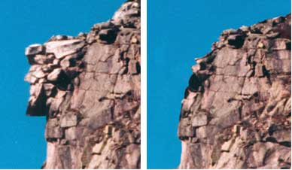
Old Man in the Mountain, NH. Face fell off due to weathering by gravity

Slide 11
Weathering and Erosion
2 Step Process to Transport Sediments:
  1) Weathering breaks rocks
  2) Erosion carries sediments away

Slide 12
Weathering and Erosion
Deposition: When transported sediments are deposited on the ground or sink to the bottom of a body of water.
Rule: Largest grains will settle to bottom. Smallest grains will remain on top.

Slide 13
Weathering and Erosion
Energy of Transporting Agents:
  Fast moving water will transport large particles better than slow moving water.
  As water slows down, large particles will settle out first, then medium sized particles, then small particles.
  Result: Different sized particles will be sorted into layers.

Slide 14
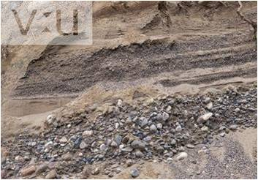
Sediment sorted by size.
Largest sediments are on the
Bottom.

Slide 15
Weathering and Erosion
Energy of Transporting Agents:
  Wind can only carry fine grains – creates dunes.
  Glaciers can carry just about anything so deposits will be mixed and not layered.

Slide 16
Weathering and Erosion
Lithification: The chemical and physical processes that transform sediments into sedimentary rocks.
  Sediments are transported downhill end up in valleys or ocean basins.
  Sediments become covered by other sediments.
  Bottom layers are subjected to increasing temperature and pressure causing lithification.

Slide 17
Weathering and Erosion
Layered Sediments
Sedimentary Rock

Slide 18
Weathering and Erosion
Lithification: 2 Parts
  Compaction: Weight of overlying sediments forces bottom sediments closer together.
  Spaces between grains allows room for ground water or oil.
  Cementation: Mineral growth between grains glues sediments together into a solid rock.
  Calcite or Iron Oxide is glue - precipitates out of ground water.

